Slide 1


<Name>
<Date>

Slide 2

Outline
Executive Summary
Introduction
Methodology
Results
Conclusion
Appendix

Slide 3
Executive Summary
To determine the price of each SpaceX Falcon9 rocket launch and if SpaceX reuse the first stage
Data collected from SpaceX API and the List of Falcon 9 and Falcon Heavy launches Wikipage updated on 9th June 2021
Some EDAs were performed to find some patterns and determine training labels and necessary features for a machine learning pipeline
SVM, Classification Trees and Logistic Regression were used to train the model for prediction
The best hyperparameters
Logistic regression: 'C': 0.01, 'penalty': 'l2', 'solver': 'lbfgs'
SVM: 'C': 1.0, 'gamma': 0.03162277660168379, 'kernel': 'sigmoid’
Decision tree: 'criterion': 'entropy', 'max_depth': 12, 'max_features': 'sqrt', 'min_samples_leaf': 2, 'min_samples_split': 2, 'splitter': 'best’
KNN: 'algorithm': 'auto', 'n_neighbors': 10, 'p’: 1
→ The decision tree performance is the best

Slide 4
Introduction
SpaceX Falcon 9 rocket launches cost only 62 million dollars while others cost upward of 165 million dollars each due to the reusability of the first stage of SpaceX.
The aim of this project is to
Determine if the first launch of SpaceX will land successfully
Find out the price of each launch

Slide 5


Slide 6
Methodology
Executive Summary
Data collection methodology:
SpaceX Rest API: https//api.spacexdata.com/v4/launches/past
Records HTML table from the List of Falcon 9 and Falcon Heavy launches Wikipage updated on 9th June 2021
Perform data wrangling
Identify and handling the missing values
Identify which columns are categorical and convert them to numerical
Identify types of outcome and then based on that adding the new column “class” with 1 is successful landing and 0 is fail one. It is used as training labels
Perform exploratory data analysis (EDA) using visualization and SQL
Perform interactive visual analytics using Folium and Plotly Dash
Perform predictive analysis using classification models
Create a colun for the class (labels)
Standardize the data Split dataset into training set and test set
Use GridSearchCV to find the best hyperparameters for each algorithm and fit the model
Use the method score to evaluate the model

Slide 7
Data Collection
SpaceX API : https//api.spacexdata.com/v4/launches/past
Webscrapping: HTML table from the List of Falcon 9 and Falcon Heavy launches Wikipage updated on 9th June 2021

Slide 8
Data Collection – SpaceX API
requests.get(spacex_url)
requests.get("https://api.spacexdata.com/v4/rockets/"+str(x))
requests.get("https://api.spacexdata.com/v4/launchpads/"+str(x))
requests.get("https://api.spacexdata.com/v4/payloads/"+load)
requests.get("https://api.spacexdata.com/v4/cores/"+core['core'])
https://github.com/thuydan80/Data-Science-Capstone-Project/blob/main/Spacex-data-collection-api_Final.ipynb
requests.get(spacex_url)
spaceXdata = data[['rocket', 'payloads', 'launchpad', 'cores', 'flight_number', 'date_utc']]
getLaunchSite
getBoosterVersion
getPayloadData
getCoreData
Filter the dataset using only Falcon 9

Slide 9
Data Collection - Scraping
Get a html object -> find all tables → get the 3rd table → get column names → create an empty launch_dict → fill the parsed recored --> convert launch_dict to dataframe.
https://github.com/thuydan80/Data-Science-Capstone-Project/blob/main/Spacex_Webscraping_Final.ipynb
requests.get(static_url)
soup.find_all('table')
html_tables[2]
Get column names and create an empty launch_dict
fill in the parsed launch record values into launch_dict
Convert launch_dict to dataframe

Slide 10
Data Wrangling
isnulll()
df.dtypes
Identify and handling missing values → idenfity types of landing_outcomes → create a landing outcome label from Outcome column and save it to a new column ‘class’
https://github.com/thuydan80/Data-Science-Capstone-Project/blob/main/Spacex-Data%20wrangling_Final.ipynb
df['Outcome'].value_counts()
landing_outcomes = df['Outcome'].value_counts()
bad_outcomes=set(landing_outcomes.keys()[[1,3,5,6,7]])
landing_class = [0 if elem in bad_outcomes else 1 for elem in df['Outcome’] ]
df['Class']=landing_class

Slide 11
EDA with Data Visualization
Scatter point plots to see how features affect the launch outcome:
FlightNumber vs PayLoadMass
FlightNumber vs LaunchSite
FlightNumber vs OrbitType
PayLoad vs OrbitType
PayLoad vs LaunchSite
Bar chart to check the relationship between success rate and each orbit
Line chart with class vs year to get the average launch success trend
https://github.com/thuydan80/Data-Science-Capstone-Project/blob/main/jupyter-labs-eda-dataviz.ipynb

Slide 12
EDA with SQL
select unique(LAUNCH_SITE) from SPACEXTBL
select * from SPACEXTBL where LAUNCH_SITE like 'CCA%' LIMIT 5
select SUM(payload_mass__kg_) from SPACEXTBL where customer like 'NASA (CRS)'
select AVG(payload_mass__kg_) from SPACEXTBL where booster_version = 'F9 v1.1’
select unique(landing__outcome) from SPACEXTBL
select MIN(DATE) from SPACEXTBL where landing__outcome='Success (ground pad)’
select booster_version from SPACEXTBL where landing__outcome='Success (drone ship)' and payload_mass__kg_>4000 and payload_mass__kg_<6000
select COUNT(mission_outcome) as Total, mission_outcome from SPACEXTBL GROUP BY mission_outcome
select booster_version from SPACEXTBL where payload_mass__kg_ = (select max(payload_mass__kg_) from SPACEXTBL)
select * from SPACEXTBL where YEAR(DATE)=2015
select COUNT(landing__outcome) as Total, landing__outcome from SPACEXTBL where YEAR(DATE)<=2017 and YEAR(DATE)>=2010 GROUP BY landing__outcome order by Total desc
https://github.com/thuydan80/Data-Science-Capstone-Project/blob/main/Spacex-eda-sql-coursera_Final.ipynb

Slide 13
Build an Interactive Map with Folium
The markers, circles of launch sites (CCAFS LC-40, CCAFS SLC-40, KSC LC-39A, VAFB SLC-4E) were created
Mark the success/failed launches for each site on the map using MarkerCluster()
The distances between a launch site to its proximities to coastline and airport
Adding those objects to check if the launch site in close proximities to coastline and airport or not
https://github.com/thuydan80/Data-Science-Capstone-Project/blob/main/Spacex_launch_site_location_folium.ipynb

Slide 14
Build a Dashboard with Plotly Dash
Pie charts to show the total successful launches count for all sites and for each site
A scatter chart to show the correlation between payload and launch success for all sites and for each site
The purpose to use these charts to discover which site has the largest successful launches, the highest successful rate and which payload ranges has the highest launch success rate and lowest one.
https://github.com/thuydan80/Data-Science-Capstone-Project/blob/main/spacex_dash_app.py

Slide 15
Predictive Analysis (Classification)
Standardize the dataset → split the dataset into training and test sets exclusively → use GridSearchCV to find the best hyperparameters → fit the model with training set using logistic regression, decision tree, svm and KNN --> use the method score to evaluate each model
All models have the same score which is 0.83 but the decision tree has the highest accuracy 0.89 --> the model with decision tree is the best
https://github.com/thuydan80/Data-Science-Capstone-Project/blob/main/SpaceX_Machine%20Learning%20Prediction_Part_5_final.ipynb

Slide 16
Results
Exploratory data analysis results
Interactive analytics demo in screenshots
Predictive analysis results

Slide 17


Slide 18
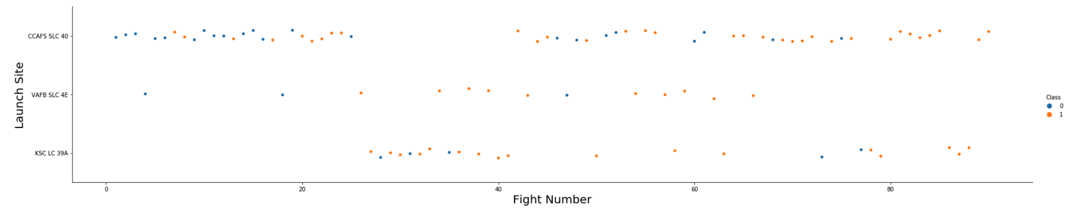
Flight Number vs. Launch Site
As the flight number increases , the success rate of the first launch at each site seems to be increased

Slide 19
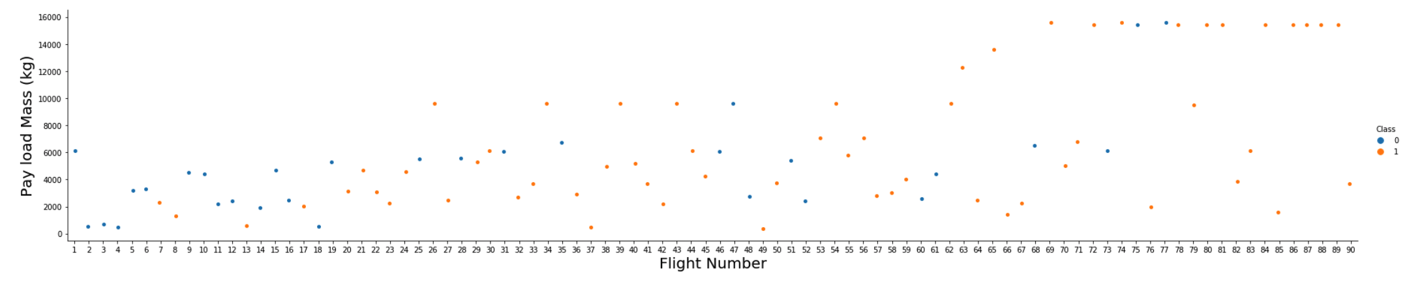
Payload vs. Launch Site
As the flight number increases, the first stage is more likely to land successfully. The seemspayload mass is also important; it the more massive the payload, the less likely the first stage will return

Slide 20
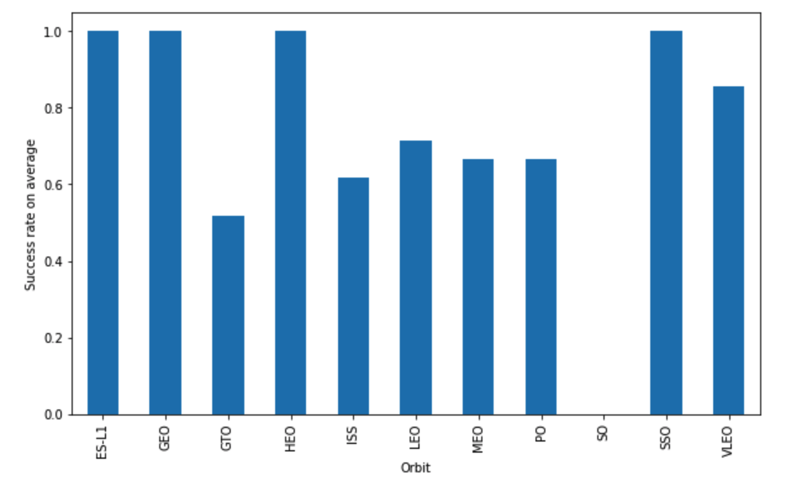
Success Rate vs. Orbit Type
ES-L1, GEO, HEO and SSO have the highest success rate
GTO has the lowest success rate

Slide 21
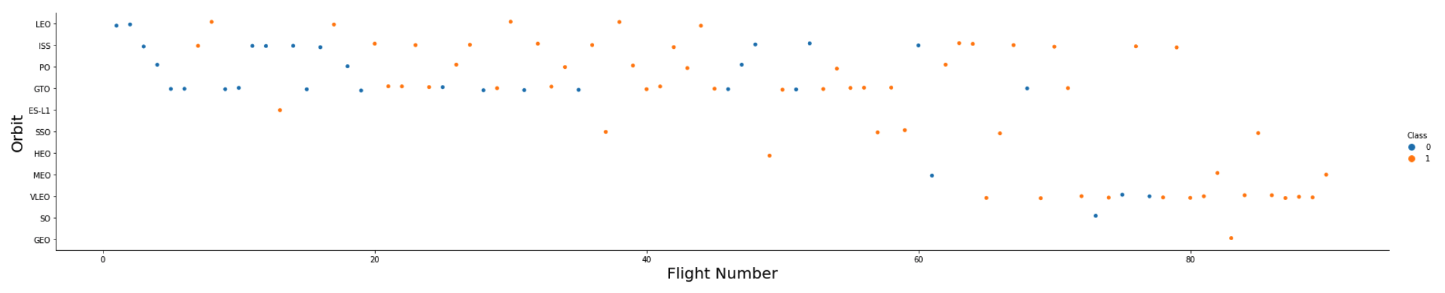
Flight Number vs. Orbit Type
In the LEO orbit the Success appears related to the number of flights; on the other hand, there seems to be no relationship between flight number when in GTO orbit.

Slide 22
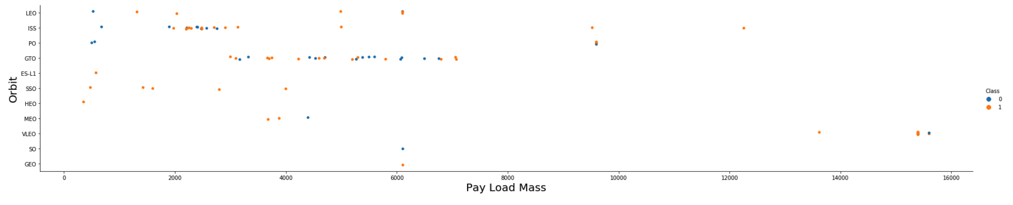
Payload vs. Orbit Type
Heavy payloads have a negative influence on GTO orbits and positive on GTO and Polar LEO (ISS) orbits

Slide 23
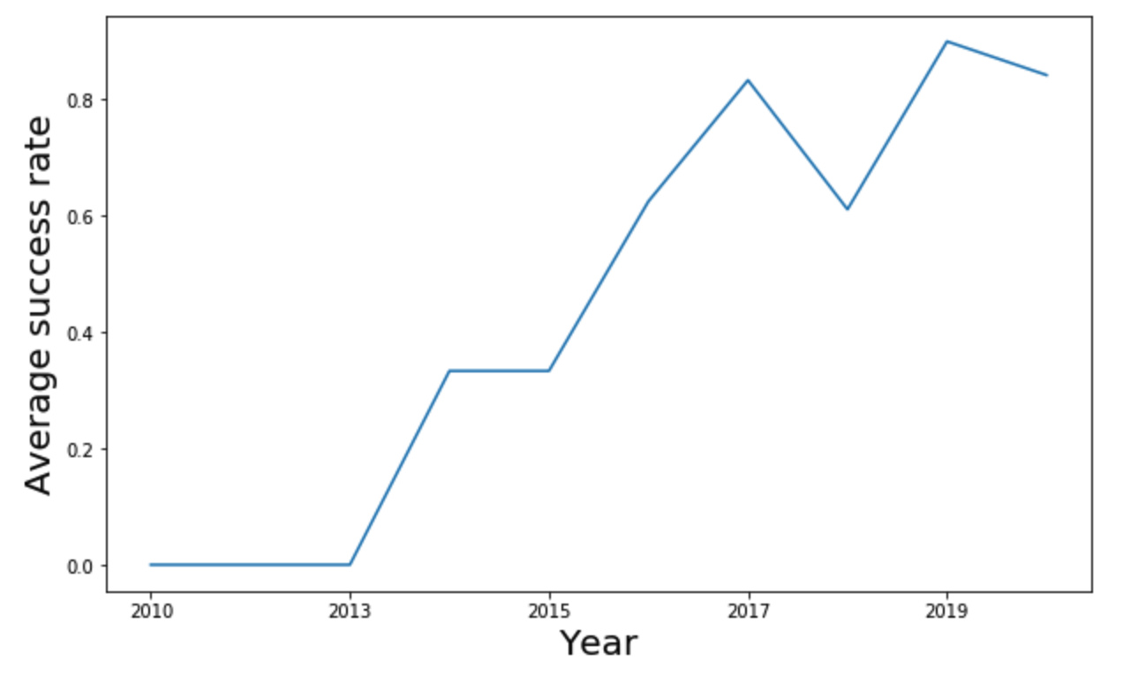
Launch Success Yearly Trend
The sucess rate since 2013 kept increasing till 2020

Slide 24
All Launch Site Names
%sql select unique(LAUNCH_SITE) from SPACEXTBL
CCAFS LC-40
CCAFS SLC-40
KSC LC-39A
VAFB SLC-4E

Slide 25
Launch Site Names Begin with 'CCA'
%sql select * from SPACEXTBL where LAUNCH_SITE like 'CCA%' LIMIT 5
DATE | time__utc_ | booster_version | launch_site | payload | payload_mass__kg_ | orbit | customer | mission_outcome | landing__outcome
2010-06-04 | 18:45:00 | F9 v1.0 B0003 | CCAFS LC-40 | Dragon Spacecraft Qualification Unit | 0 | LEO | SpaceX | Success | Failure (parachute)
2010-12-08 | 15:43:00 | F9 v1.0 B0004 | CCAFS LC-40 | Dragon demo flight C1, two CubeSats, barrel of Brouere cheese | 0 | LEO (ISS) | NASA (COTS) NRO | Success | Failure (parachute)
2012-05-22 | 07:44:00 | F9 v1.0 B0005 | CCAFS LC-40 | Dragon demo flight C2 | 525 | LEO (ISS) | NASA (COTS) | Success | No attempt
2012-10-08 | 00:35:00 | F9 v1.0 B0006 | CCAFS LC-40 | SpaceX CRS-1 | 500 | LEO (ISS) | NASA (CRS) | Success | No attempt
2013-03-01 | 15:10:00 | F9 v1.0 B0007 | CCAFS LC-40 | SpaceX CRS-2 | 677 | LEO (ISS) | NASA (CRS) | Success | No attempt

Slide 26
Total Payload Mass
%sql select SUM(payload_mass__kg_) from SPACEXTBL where customer like 'NASA (CRS)’
→ 45596 kg

Slide 27
Average Payload Mass by F9 v1.1
%sql select AVG(payload_mass__kg_) from SPACEXTBL where booster_version = 'F9 v1.1’
→ 2928.40 kg

Slide 28
First Successful Ground Landing Date
sql select MIN(DATE) from SPACEXTBL where landing__outcome='Success (ground pad)’
--> 2015-12-22

Slide 29
Successful Drone Ship Landing with Payload between 4000 and 6000
%sql select booster_version from SPACEXTBL where landing__outcome='Success (drone ship)' and payload_mass__kg_>4000 and payload_mass__kg_<6000
→
booster_version
F9 FT B1022
F9 FT B1026
F9 FT B1021.2
F9 FT B1031.2

Slide 30
Total Number of Successful and Failure Mission Outcomes
%sql select COUNT(mission_outcome) as Total, mission_outcome from SPACEXTBL GROUP BY mission_outcome
→
total | mission_outcome
1 | Failure (in flight)
99 | Success
1 | Success (payload status unclear)

Slide 31
Boosters Carried Maximum Payload
booster_version
F9 B5 B1048.4
F9 B5 B1049.4
F9 B5 B1051.3
F9 B5 B1056.4
F9 B5 B1048.5
F9 B5 B1051.4
F9 B5 B1049.5
F9 B5 B1060.2
F9 B5 B1058.3
F9 B5 B1051.6
F9 B5 B1060.3
F9 B5 B1049.7
%sql select booster_version from SPACEXTBL where payload_mass__kg_ = (select max(payload_mass__kg_) from SPACEXTBL)

Slide 32
2015 Launch Records
%sql select * from SPACEXTBL where YEAR(DATE)=2015
DATE | time__utc_ | booster_version | launch_site | payload | payload_mass__kg_ | orbit | customer | mission_outcome | landing__outcome
2015-01-10 | 09:47:00 | F9 v1.1 B1012 | CCAFS LC-40 | SpaceX CRS-5 | 2395 | LEO (ISS) | NASA (CRS) | Success | Failure (drone ship)
2015-02-11 | 23:03:00 | F9 v1.1 B1013 | CCAFS LC-40 | DSCOVR | 570 | HEO | U.S. Air Force NASA NOAA | Success | Controlled (ocean)
2015-03-02 | 03:50:00 | F9 v1.1 B1014 | CCAFS LC-40 | ABS-3A Eutelsat 115 West B | 4159 | GTO | ABS Eutelsat | Success | No attempt
2015-04-14 | 20:10:00 | F9 v1.1 B1015 | CCAFS LC-40 | SpaceX CRS-6 | 1898 | LEO (ISS) | NASA (CRS) | Success | Failure (drone ship)
2015-04-27 | 23:03:00 | F9 v1.1 B1016 | CCAFS LC-40 | Turkmen 52 / MonacoSAT | 4707 | GTO | Turkmenistan National Space Agency | Success | No attempt
2015-06-28 | 14:21:00 | F9 v1.1 B1018 | CCAFS LC-40 | SpaceX CRS-7 | 1952 | LEO (ISS) | NASA (CRS) | Failure (in flight) | Precluded (drone ship)
2015-12-22 | 01:29:00 | F9 FT B1019 | CCAFS LC-40 | OG2 Mission 2 11 Orbcomm-OG2 satellites | 2034 | LEO | Orbcomm | Success | Success (ground pad)

Slide 33
Rank Landing Outcomes Between 2010-06-04 and 2017-03-20
%sql select COUNT(landing__outcome) as Total, landing__outcome from SPACEXTBL where YEAR(DATE)<=2017 and YEAR(DATE)>=2010 GROUP BY landing__outcome order by Total desc
total | landing__outcome
12 | No attempt
12 | Success (drone ship)
8 | Success (ground pad)
5 | Failure (drone ship)
4 | Controlled (ocean)
2 | Failure (parachute)
2 | Uncontrolled (ocean)
1 | Precluded (drone ship)

Slide 34


Slide 35
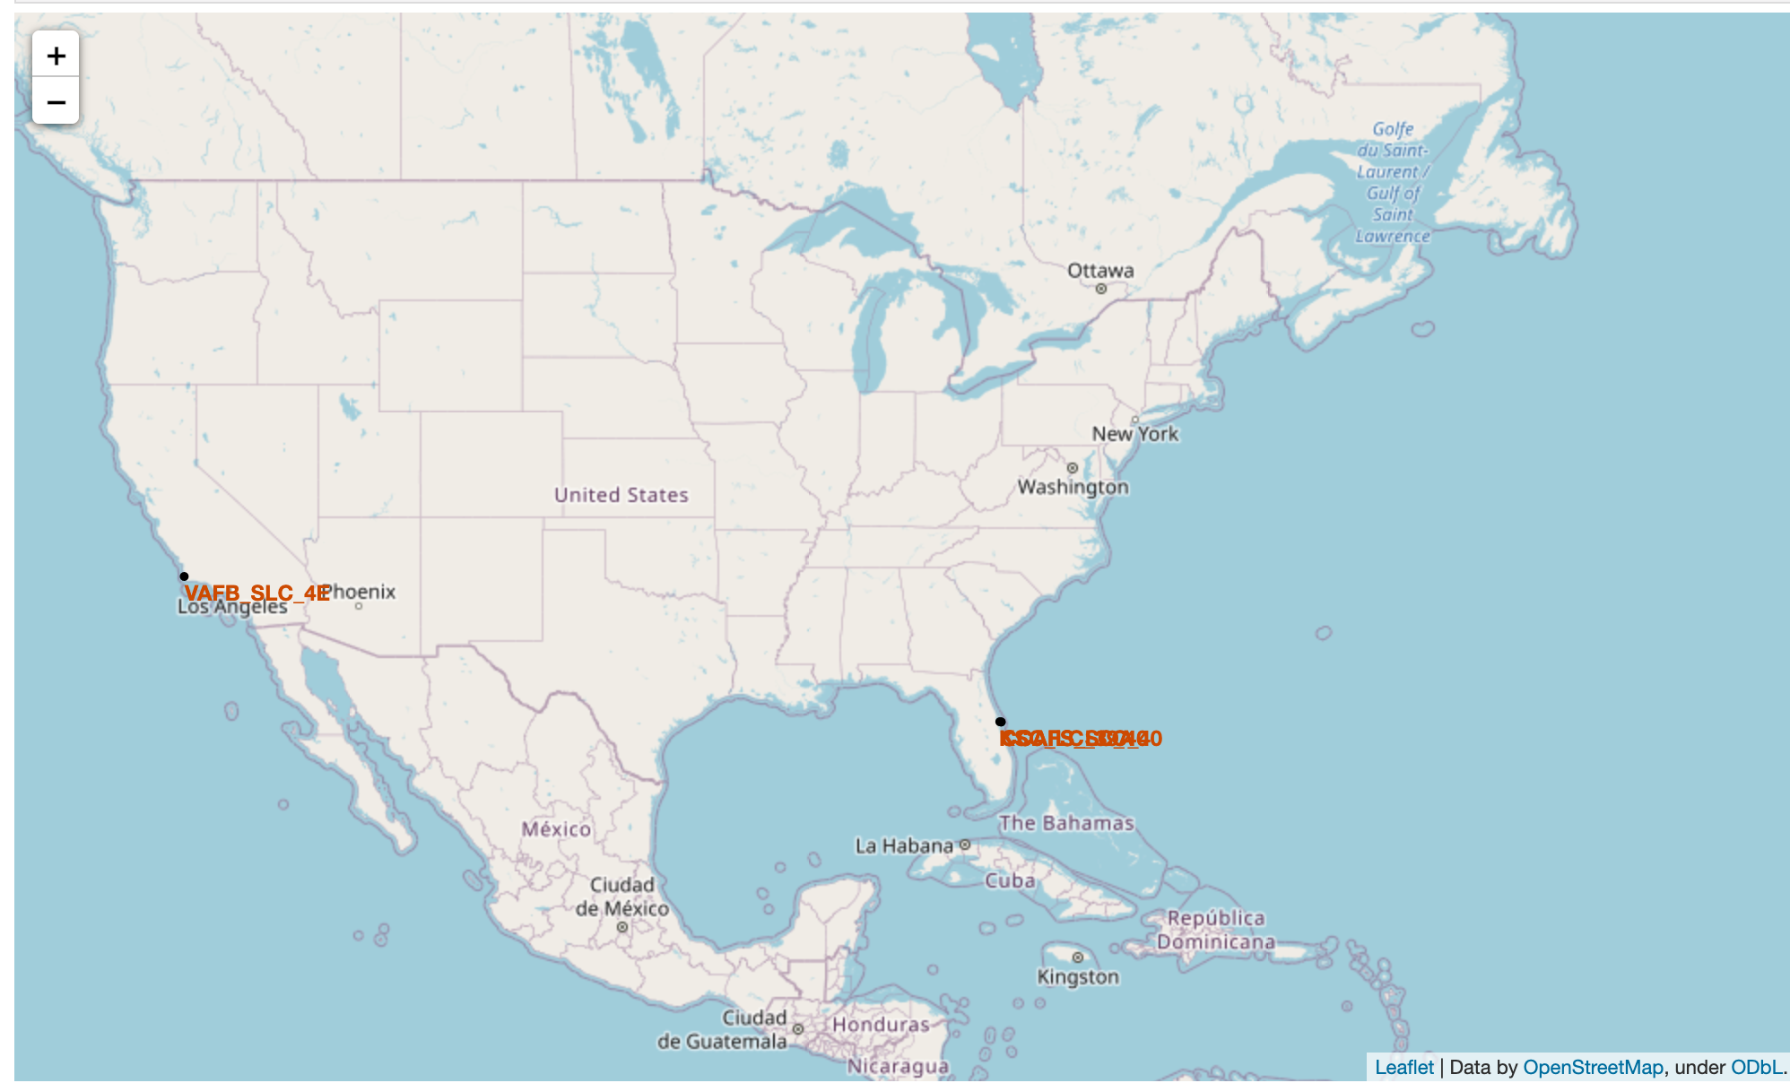
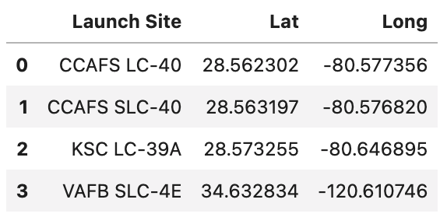
Launch Site Map
4 launch sites are shown in the map

Slide 36
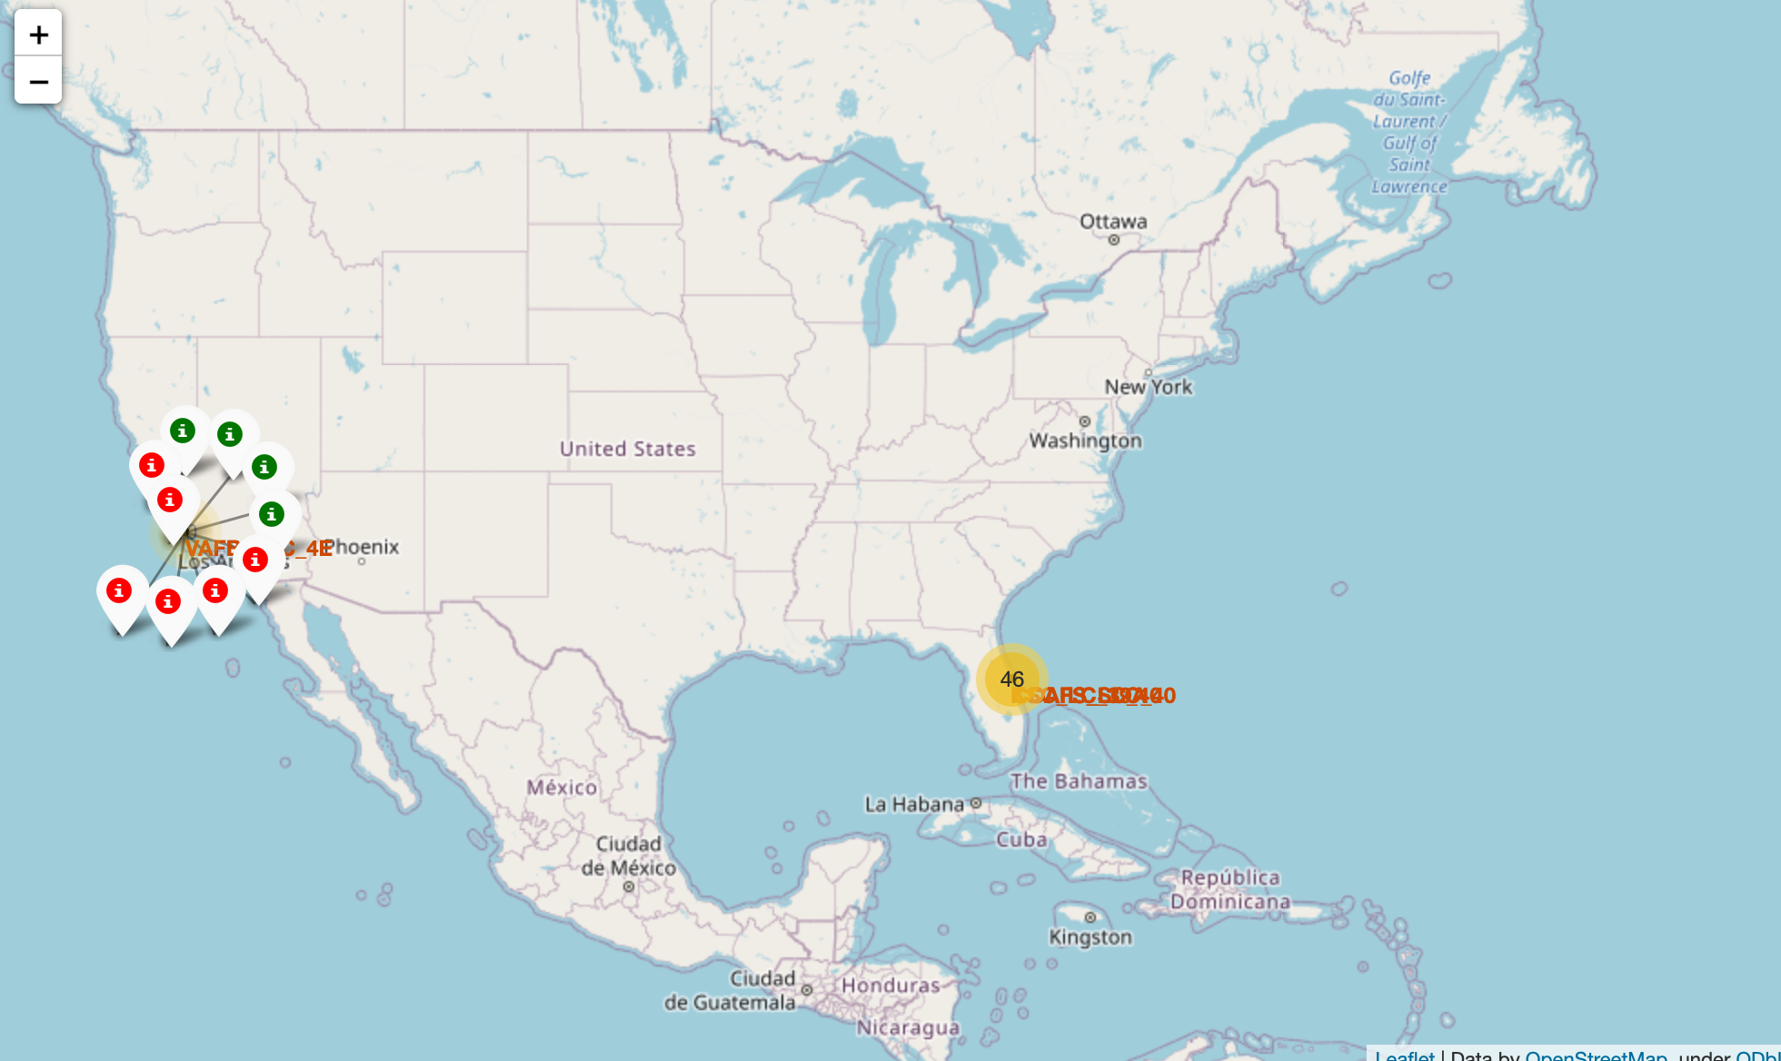
Map with Success and Failure Launches for each site
Show success and failure launches for each site. For example, in site VAFB_SLC_4E, there are 4 success launches appeared in green and 6 failures shown in red

Slide 37
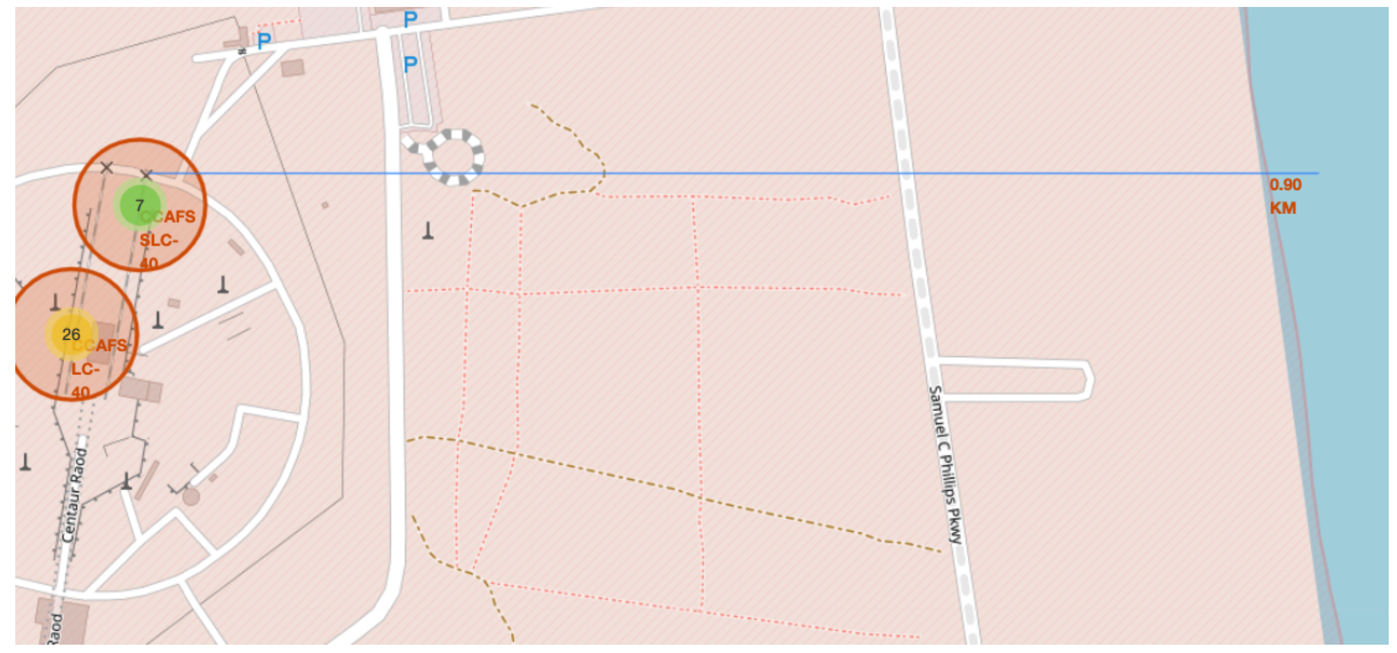
Distance between a launch site and its proximities
Distance from CCAFS_SLC_40 to the coastline is 0.9 km

Slide 38


Slide 39
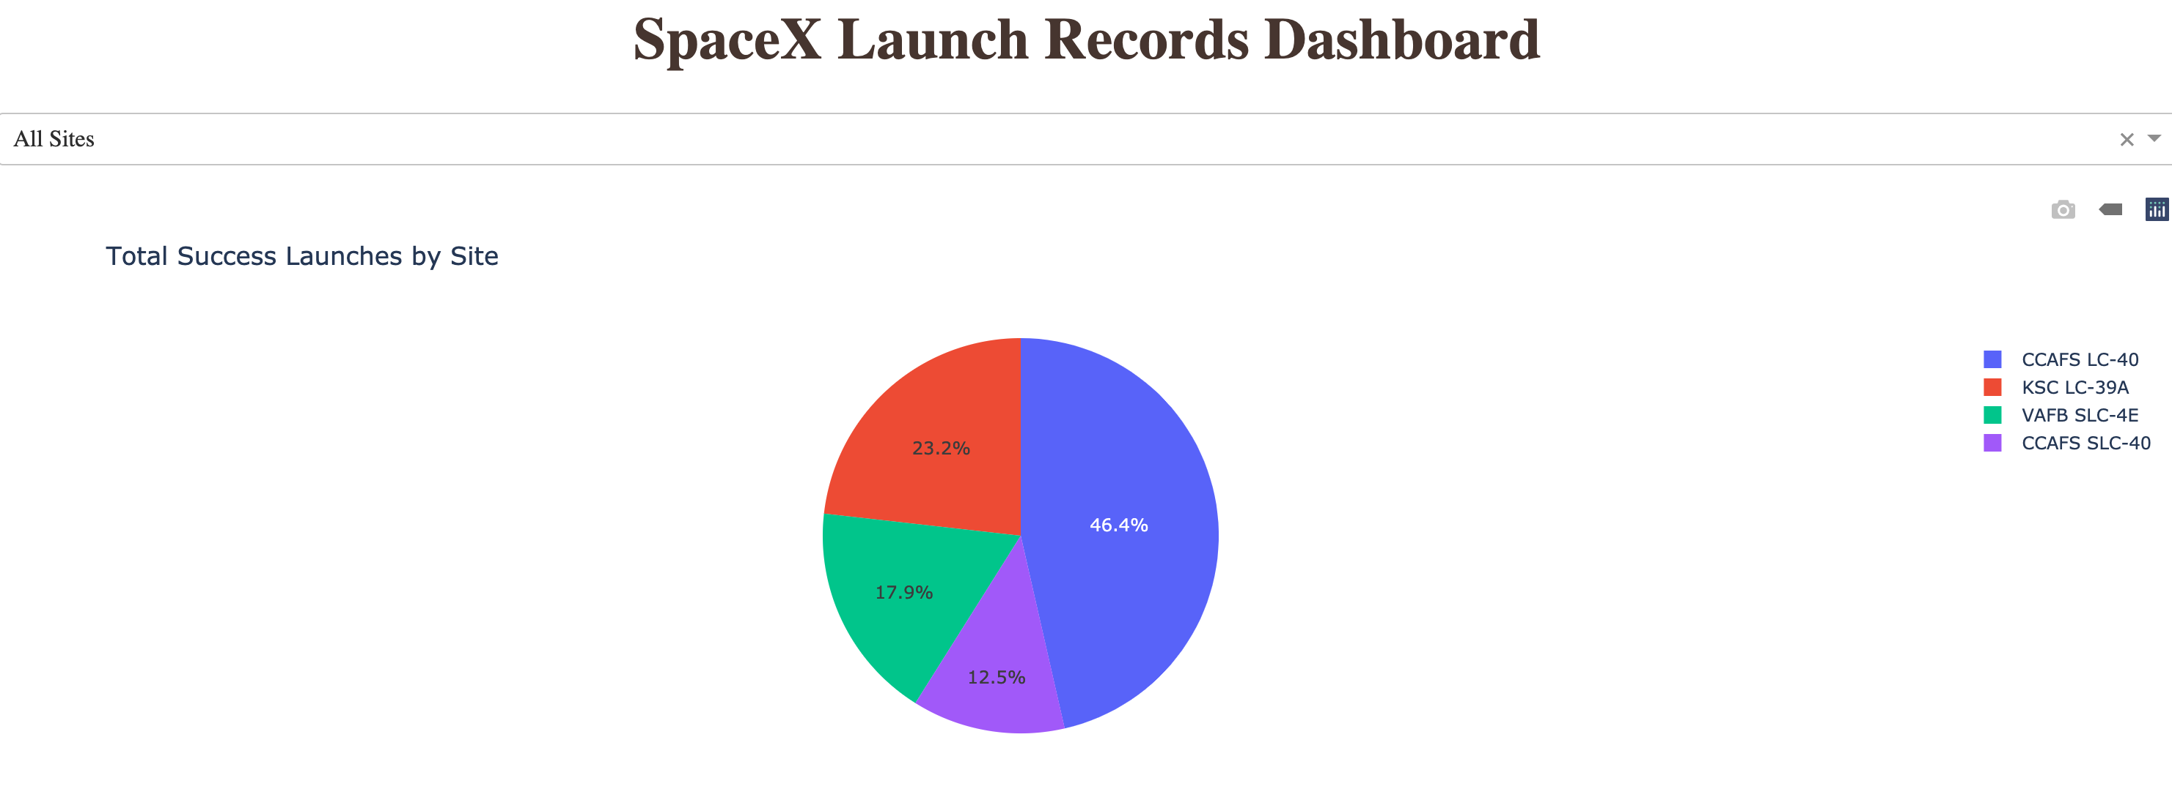
Pie chart of Total Success Launches for all Sites
CCAFS LC-40 has a highest number of successful launches while CCAFS SLC-40 has a lowest number one

Slide 40
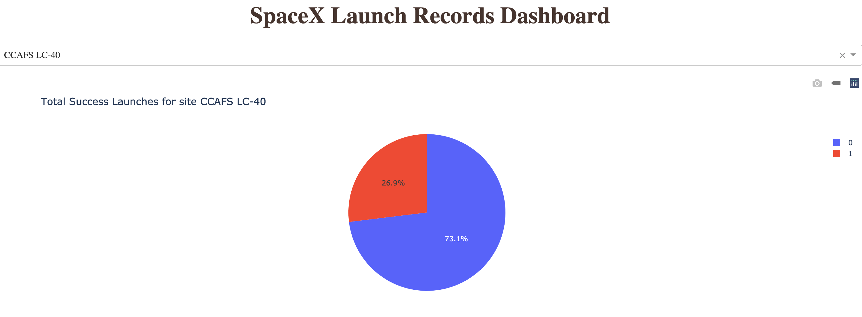
Pie chart of Total success launches for each site
At the site CCAFS LC-40, success rate is 73.1%

Slide 41
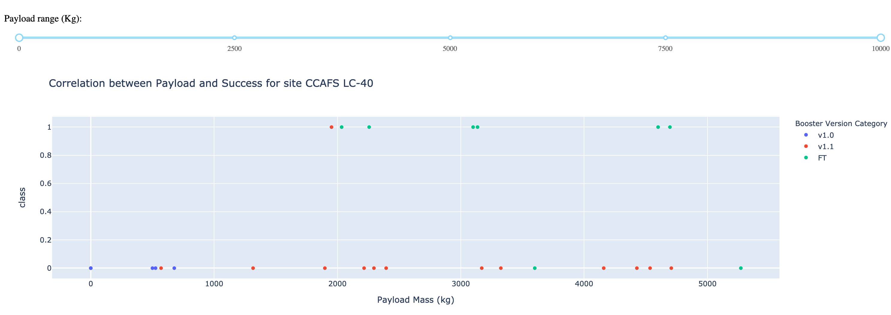
Scatter point plot of Payload vs Success Launch
At CCAFS LC-40, payload from 2000 kg with Booster version FT has the most success launches

Slide 42


Slide 43
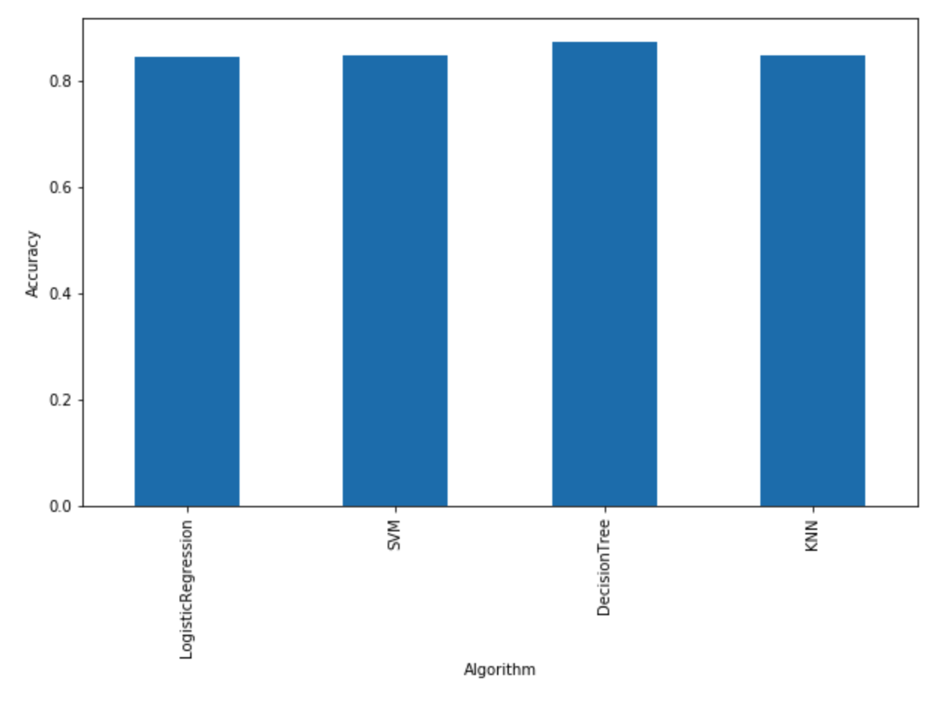
Classification Accuracy
The decision tree model has the highest accuracy

Slide 44
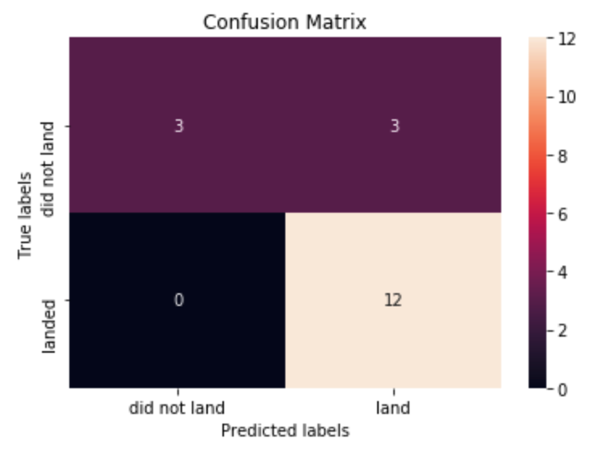
Confusion Matrix
Decision tree can distinguish between the different classes. The major problem is false positives.

Slide 45
Conclusions
Launch Site, Payload, Booster version have an effect on the successful/failure launch.
CCAFS LC-40 has the largest successful launches
KSC LC-39 has the highest successful rate
Landing on ground pad has the highest chance to be successful
Payload range (2000, 5200) with FT and B4 version has the highest success rate
The classification model with decision tree give the best performance
The test accuracy for all algorithms are the same at 83%

Slide 46
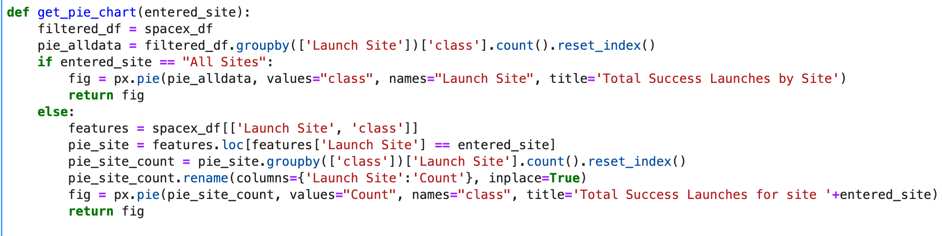
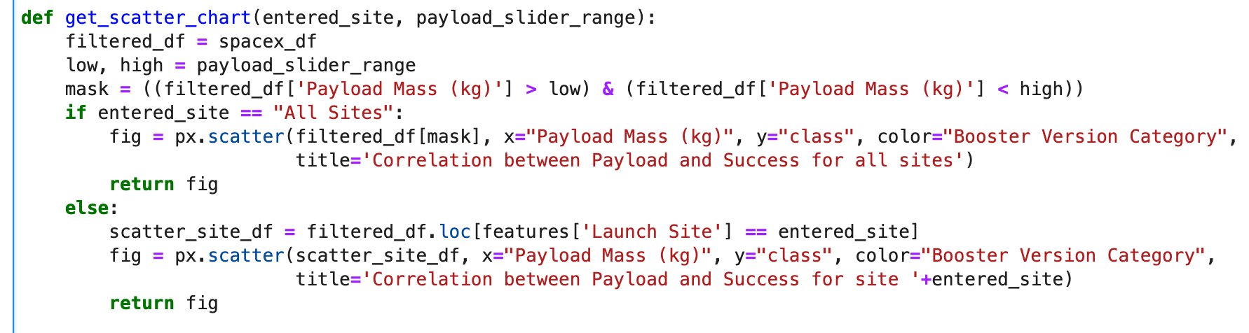
Appendix

Slide 47


